Slide 1
Python for Data Science
Poverty GP Summer University
July 15-19, 2019
Welcome!
Here are the materials
http://github.com/worldbank/Python-for-Data-Science/

Slide 2
Participant outcomes
With no prior coding skills assumed, participants should be able to:
access and combine a diverse set of datasets;
conduct data exploration and visualization;
utilize Python libraries for geospatial data and machine learning;
self-teach next steps.

Slide 3
Programming shares many concepts from everyday life.

Slide 4
Guess the output (1)
Ingredients
Half cup butter
Half cup cream
2.5 cups flour
1 t. salt
1 T. sugar
4 cups riced potatoes (cold)
Method
1. Mix all ingredients
2. Knead thoroughly
3. Form into 20 balls.
4. For each ball:
Spread flour on cloth
Roll ball in circle with rolling pin
Fry on griddle
Flip and fry other side

Slide 5
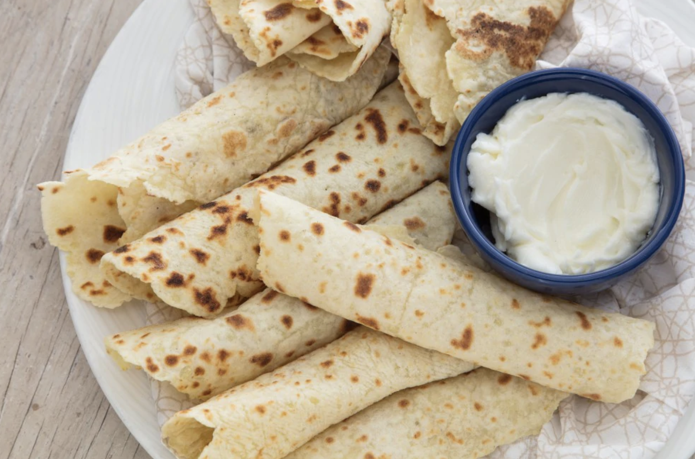
Credit: Think Python! Allen Downey
Lefse, Norwegian pancakes (makes 20)

Slide 6
Key elements of programming
A vocabulary of words, abbreviations and symbols.
Rules about what can be said and where – their syntax.
A sequence of operations to be performed in order.
Repetition of some operations (loops) or logical tests (conditions)
Sometimes, a reference to procedures defined elsewhere (functions)
Credit: Think Python! Allen Downey

Slide 7
Specialized syntax, loops, functions and logic are all common ways of thinking in other domains (like cooking).
Ingredients
Half cup butter
Half cup cream
2.5 cups flour
1 t. salt
1 T. sugar
4 cups riced potatoes (cold)
Method
1. Mix all ingredients
2. Knead thoroughly
3. Form into 20 balls.
4. For each ball:
Spread flour on cloth
Roll ball in circle with rolling pin
Fry on griddle
Flip and fry other side

Slide 8
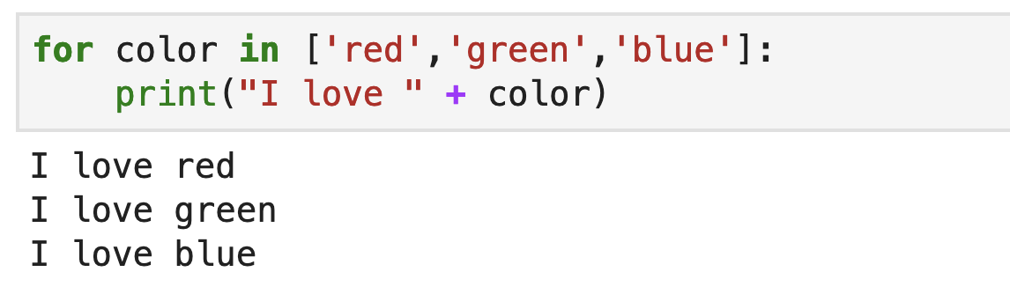
Guess the output (2)
loop
list
elements of syntax
text
syntax (indentation)

Slide 9
Data science - two popular representations:

Slide 10
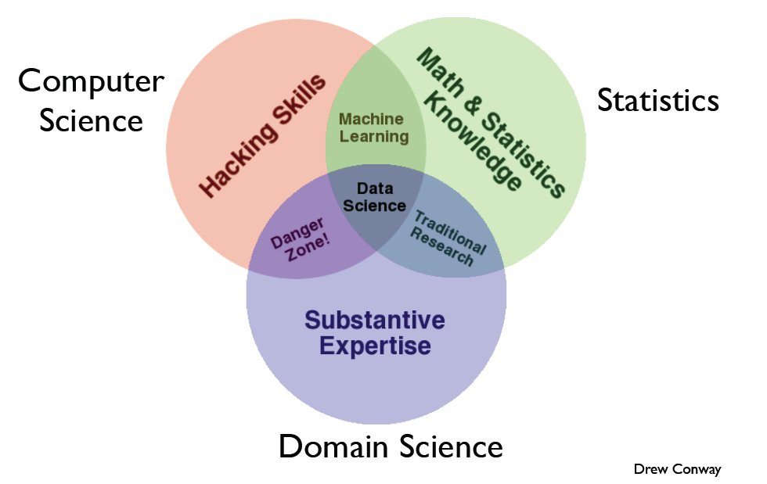
Computer
science
Math & stats
Domain expertise

Slide 11
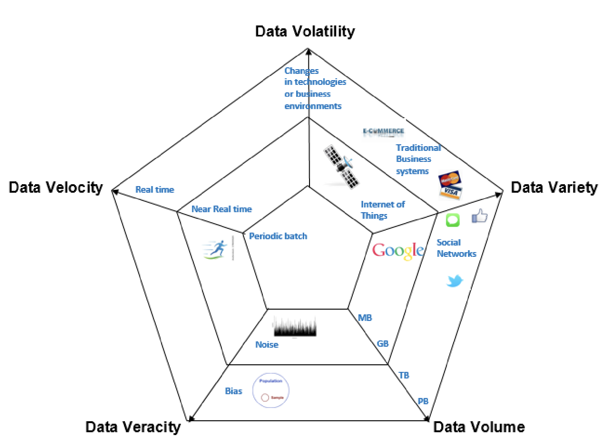
Source: IMF /
Doug Laney

Slide 12
Why Python for Data Science?

Slide 13
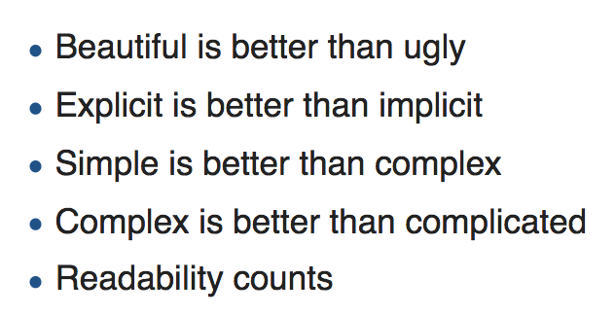
Why Python for data science?
Guido Van Rossum – the Zen of Python:
Python’s Benevolent Dictator for Life

Slide 14
Why Python for data science?
Guido Van Rossum – the Zen of Python:
Whitespace instead of symbols
tabs, indentation and line-breaks matter
code remains uncluttered
Variable types determined automatically
no need to declare the type of your variables before assigning values
Intuitive grammar
PEP8: style guide
Python’s Benevolent Dictator for Life

Slide 15
Three advantages:

Slide 16
1. Python is popular
Large user community
Well-maintained libraries
Online guidance (StackOverflow)

Slide 17
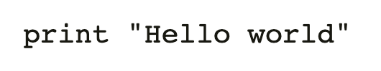
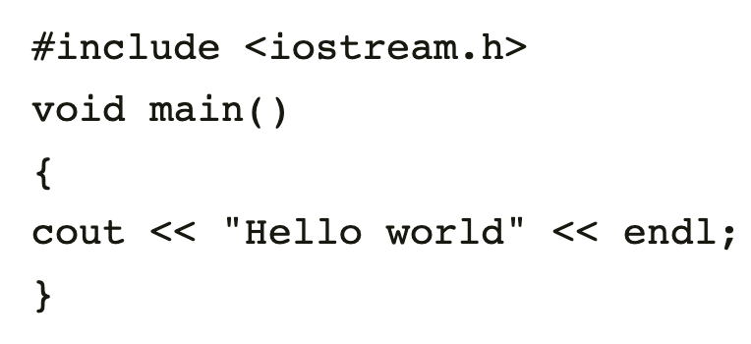
2. Easy to learn and share
WHY PEOPLE LIKE IT:
Code is intuitive and expressive (compare C++)
Suited to large quantities of data
Transparent, reproducible research through Jupyter Notebooks

Slide 18
3. Thriving ecosystem of tools
Get data
Clean data
Modeling and analysis
Evaluate and present
Data science work-flow
BeautifulSoup
mySQL client
API clients (Twitter, ESRI, OSMNx…)
Pandas
Geopandas
Rasterio
Numpy
scipy
statsmodel
SciKitLearn
Jupyter Notebook
Matplotlib
Flask
Examplelibraries

Slide 19
Housekeeping

Slide 20
Course outline
Day 1 | Variables, data structures, logic, functions.
Day 2 | Manipulating large tabular data (Numpy, Pandas), plotting.
Day 3 | Web data (APIs), geospatial, machine learning.
Day 4 | Call detail records, natural language processing
Housekeeping
Start time | Please arrive for 9am start!
Format | Lectures (click along) Labs (your time to write code and read resources)
Coffee and lunch breaks | Approx 10.45 - 11.00am, 12.30-2.00pm, 3.30—3.45pm
Requirements | Bring your laptop with full charge, working wifi, and a Google log-in Help your neighbors if they’re stuck!

Slide 21
Getting started
GitHub repository: github.com/worldbank/Python-for-Data-Science/
First exercise
Scroll down on GitHub ‘day_1’ page, click the link for ‘0_notebooks_intro’
Starting with Colab
Ensure you’re logged on to your Google account
Click ‘connect’
De-select ‘reset all runtimes’ and click ‘run anyway’

